Slide 1

BOOKTOPIA
WEB TECHNOLOGY
5CSE-C
-online bookstore
IU2141230158-ANAND PATEL
IU2141230168-DRASHTI PATEL

Slide 2
INTRODUCTION
Welcome to BOOKTOPIA your ultimate destination for books and more. Our user-friendly platform combines the joy of reading with the convenience of online shopping, making it easy to find your favorite reads. Enjoy a seamless experience, browse, buy, and enjoy your literary journey with just a few clicks.

Slide 3
Problem Statement:-
Creating a unique website for a bookstore that makes it really simple to locate and understand information about various books.
This website will assist in determining the most popular books in particular categories.
It's like having a smart assistant who can manage the book collection and make finding new books enjoyable and uncomplicated.

Slide 4
OBJECTIVES
Global Reach: Reach readers worldwide, breaking geographical barriers
24/7 Accessibility: Provide a platform accessible at any time, accommodating diverse time zones.
Convenience for Users: Offer a user-friendly interface for easy book discovery, purchase, and tracking.
Book Discovery: Enhance book discovery through an advanced recommendation system.
Continuous Improvement: Monitor the implementation of user suggestions and measure improvements in user satisfaction.

Slide 5
SCOPES
User-friendly design
Administrative control
Smart Search and Filtering
Book Categories and Diversity
Detailed Book Pages
Reviews and Ratings System
Book Availability and Purchase Options
Secure Transactions

Slide 6
SIGNIFICANCE
A book website is like a global library that never closes, where you can explore, pick, and enjoy a wide variety of books from anywhere letting people easily discover and enjoy all kinds of books. It makes sure there are enough copies of popular books, It's a friendly online space that brings books and readers together.

Slide 7
ARCHITECTURE & SYSTEM OVERVIEW

Slide 8
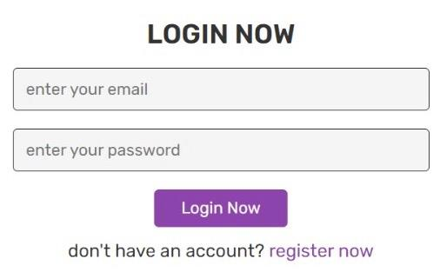
LOGIN PAGE

Slide 9
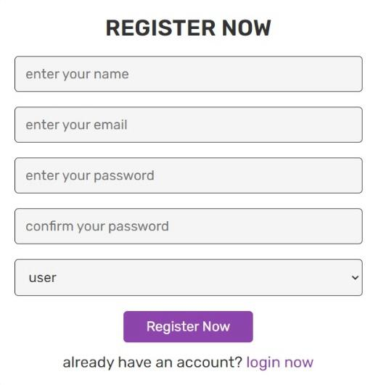
REGISTER PAGE

Slide 10
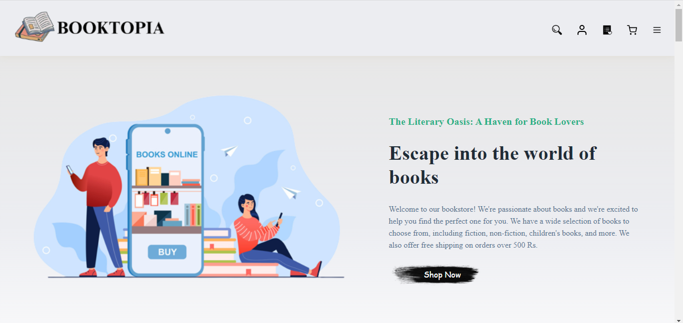
HOME PAGE

Slide 11
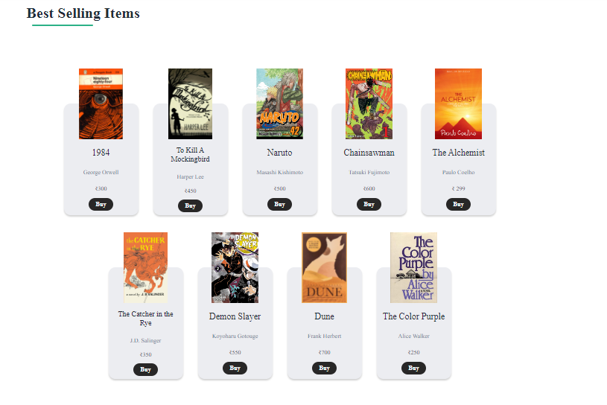
BEST SELLING ITEMS

Slide 12
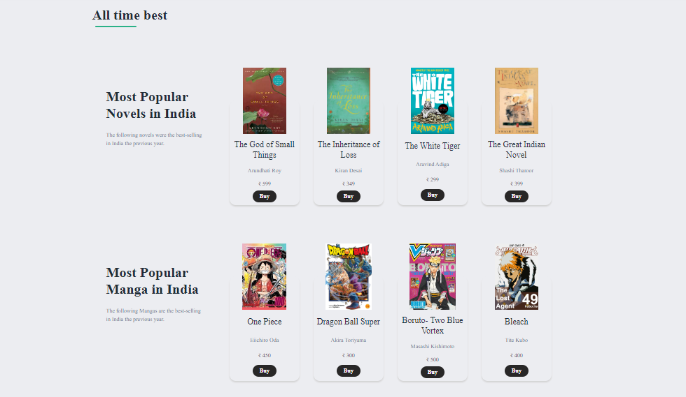
ALL TIME BEST

Slide 13
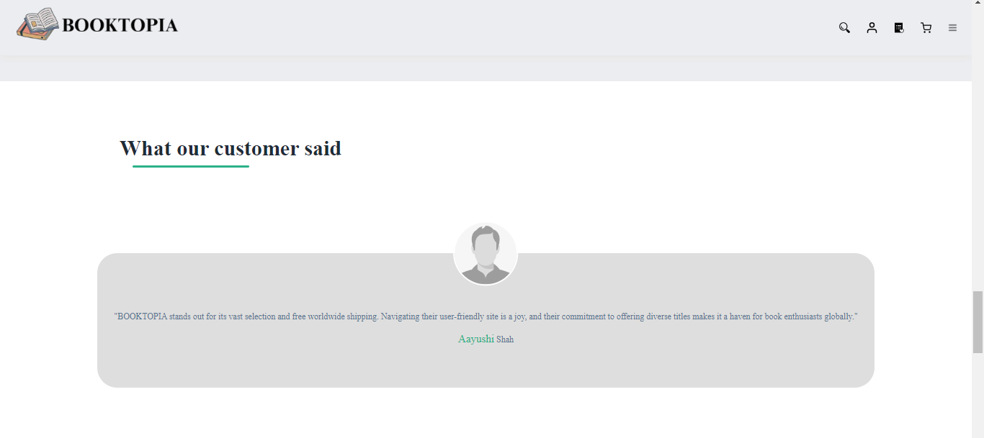
CUSTOMER REVIEW

Slide 14
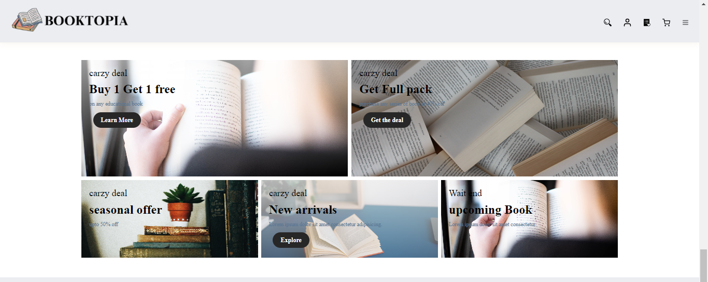
OFFER SECTION

Slide 15
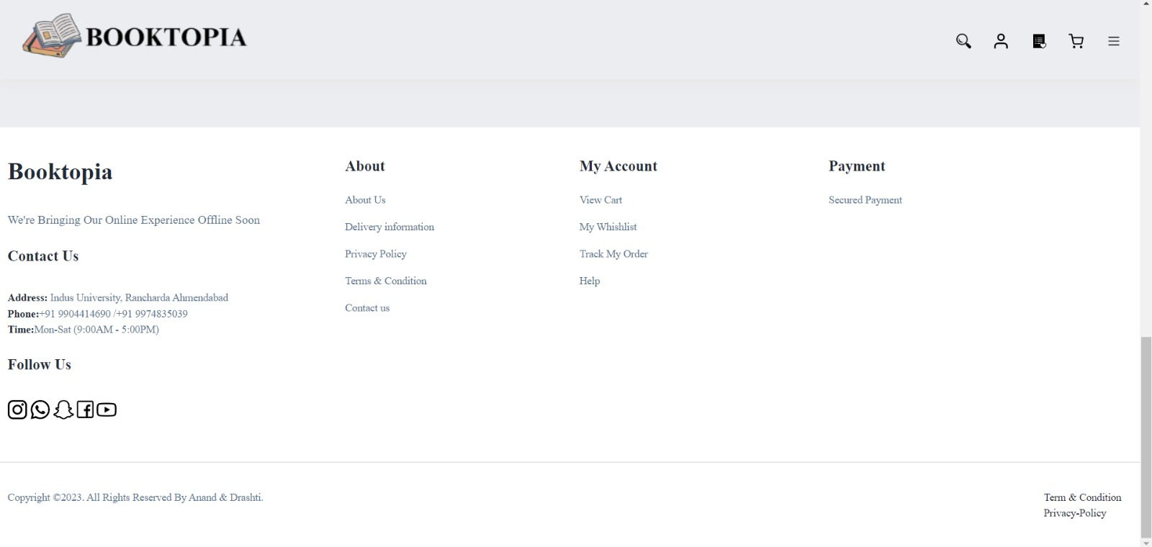
EMAIL SUBSCRIPTION

Slide 16
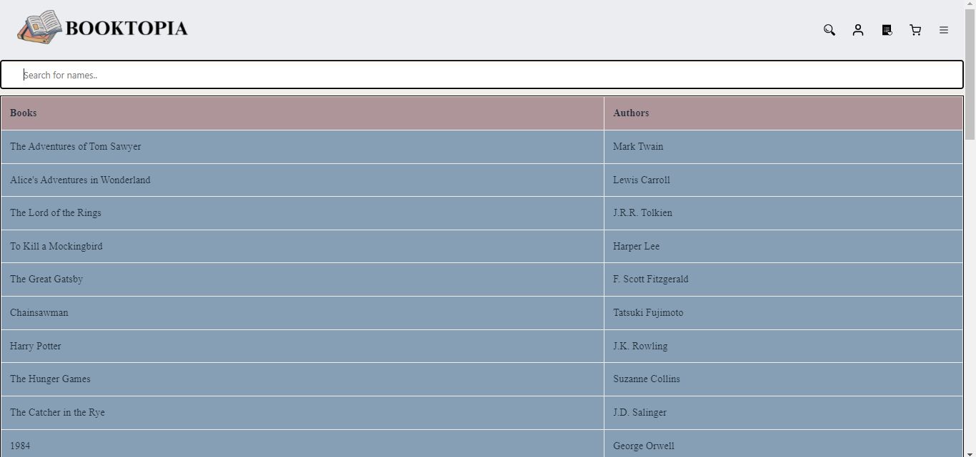
SEARCH AVAILABLE BOOKS

Slide 17
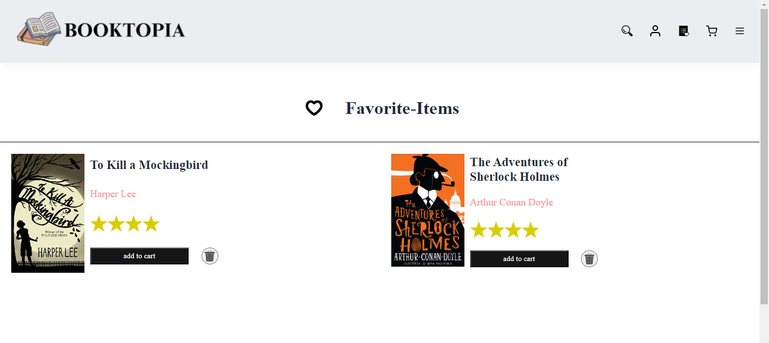
WHISH-LIST

Slide 18
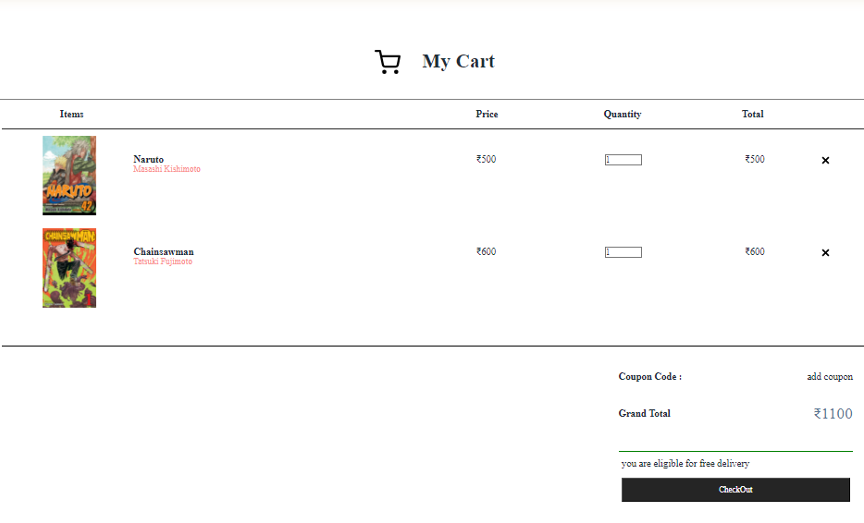
ADD TO CART

Slide 19
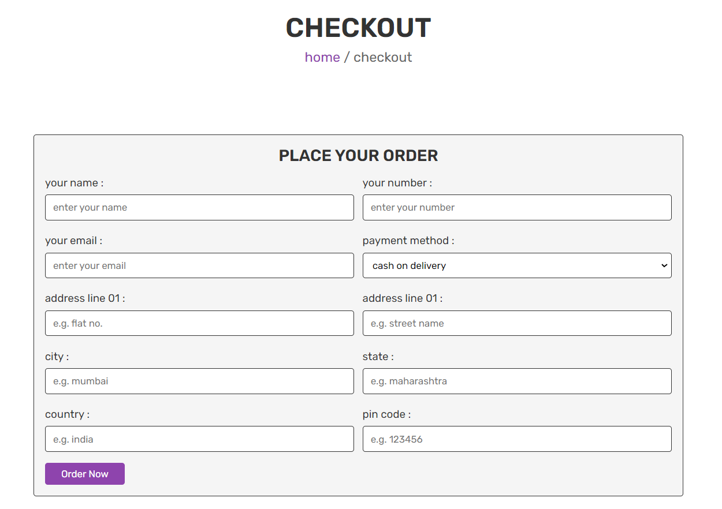
CHECKOUT PAGE

Slide 20
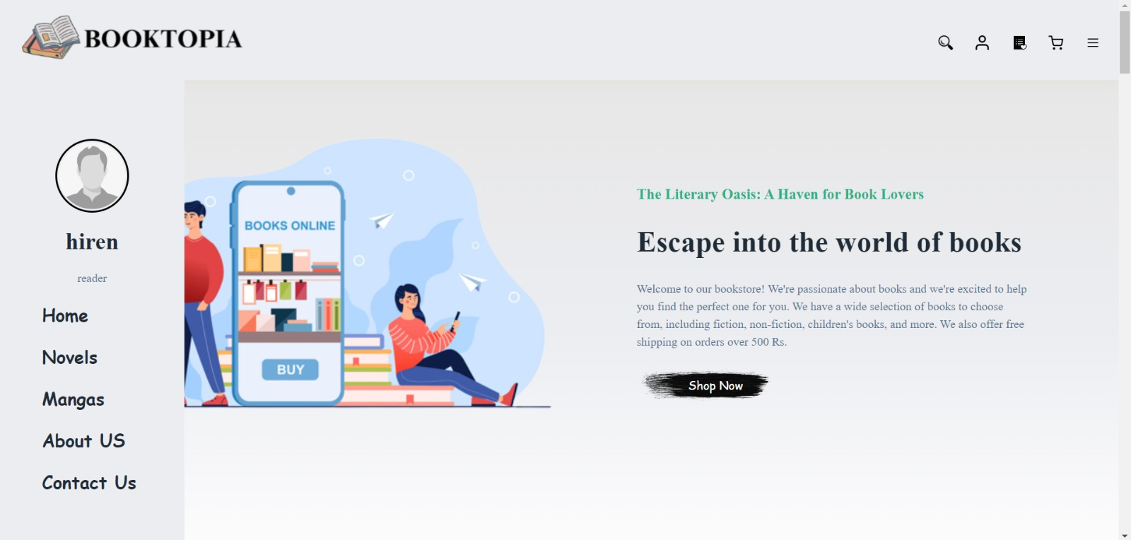
MENU

Slide 21
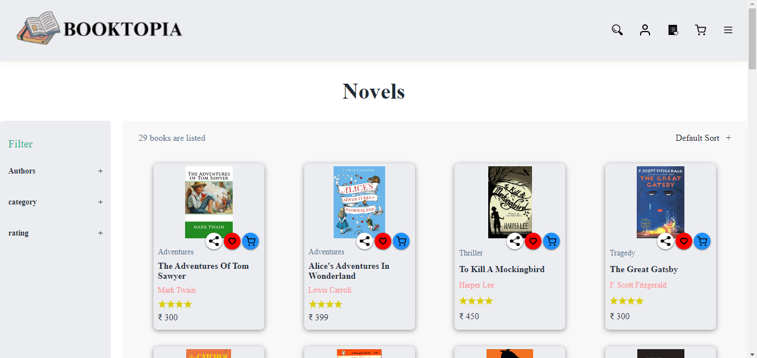
NOVELS

Slide 22
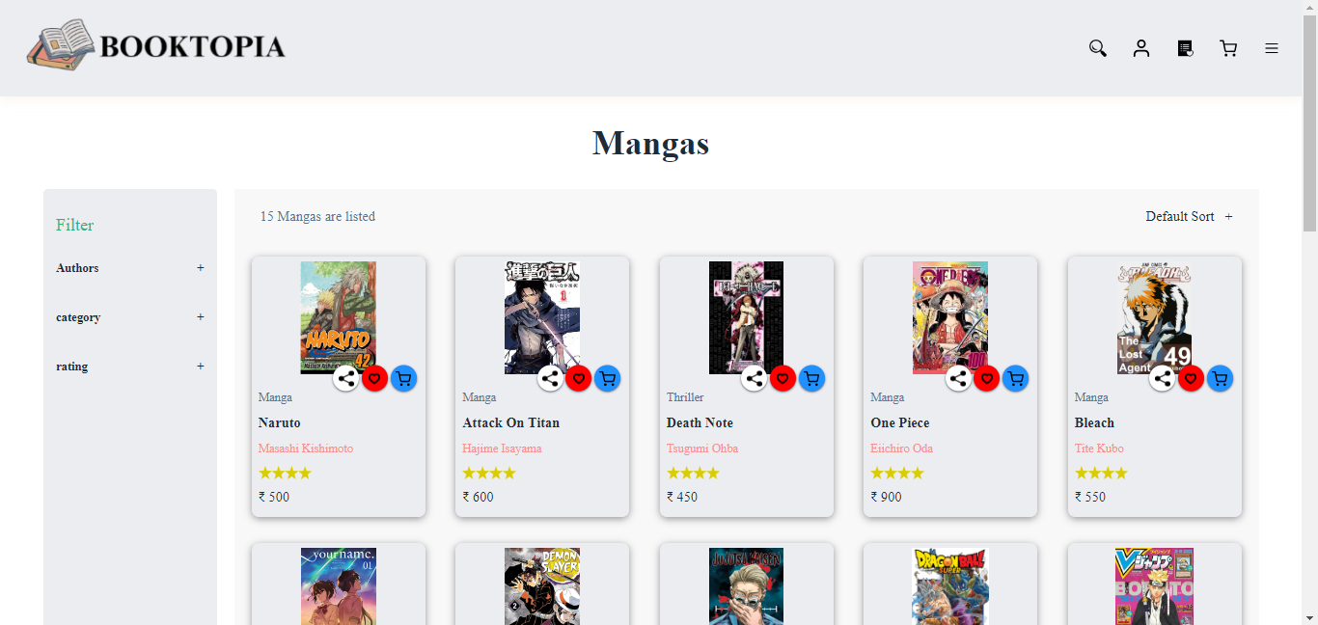
MANGAS

Slide 23
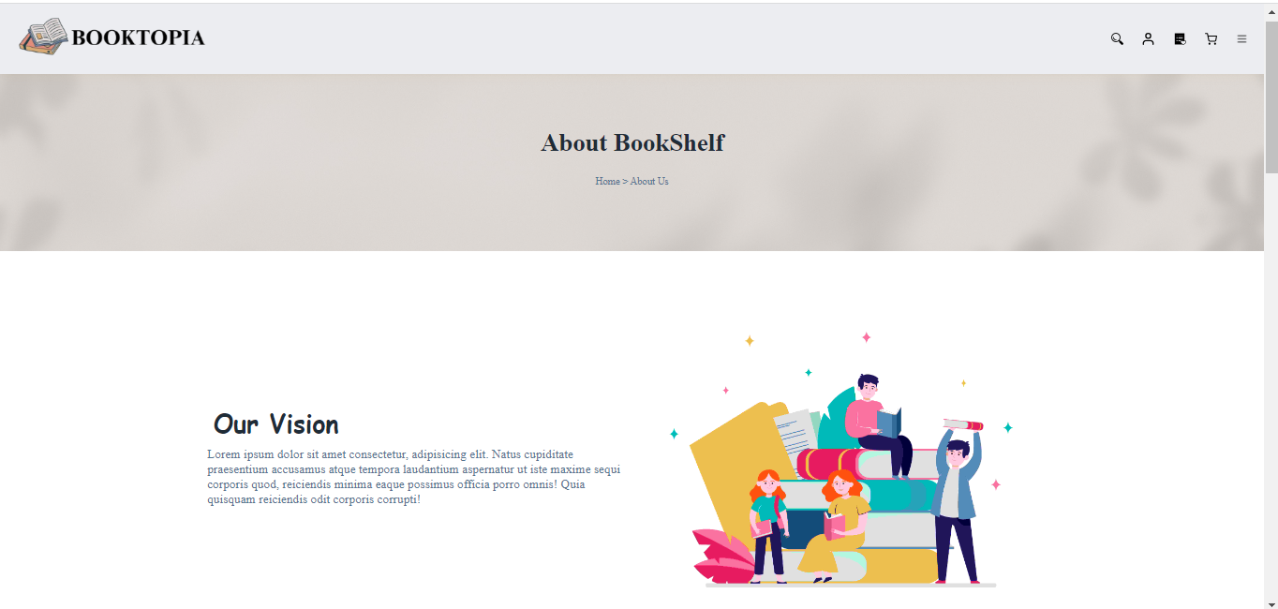
ABOUT US

Slide 24
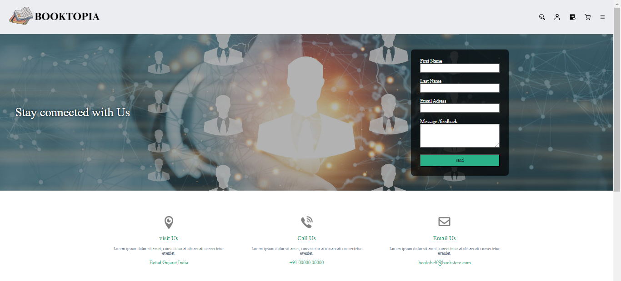
CONTACT US

Slide 25
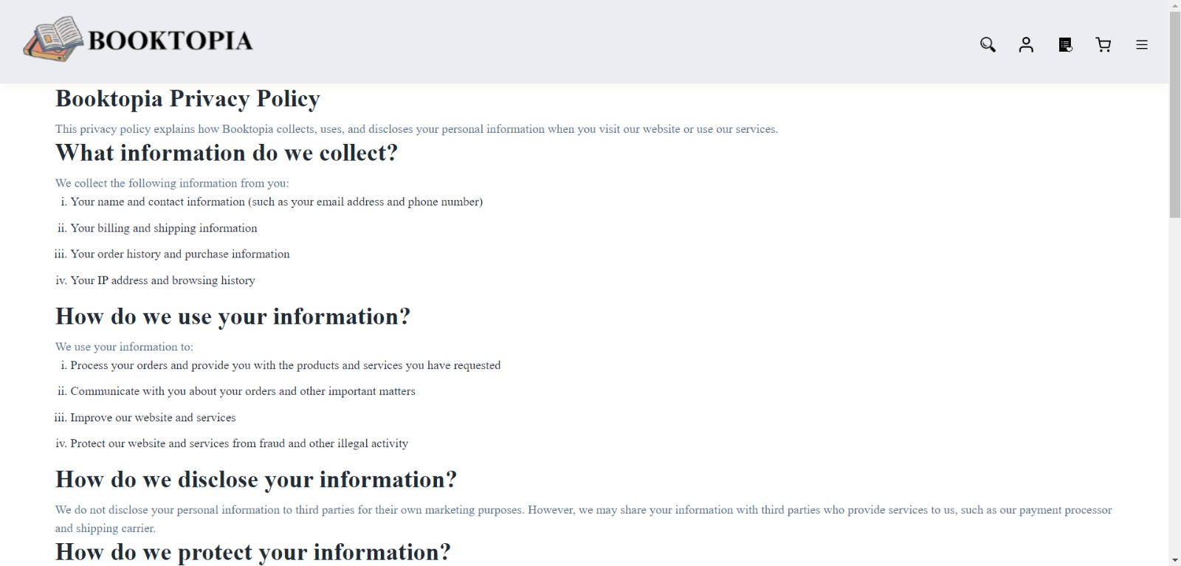
PRIVACY POLICY

Slide 26
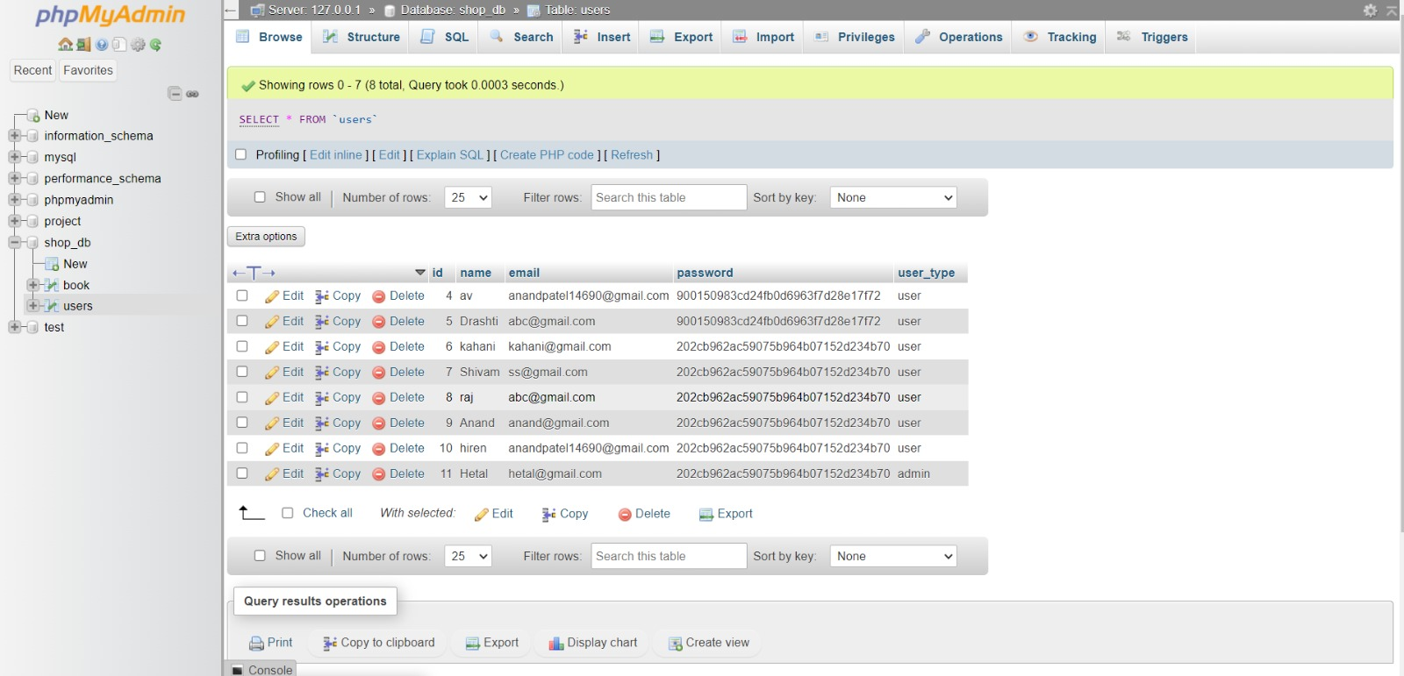
DATABASE DESIGN

Slide 27
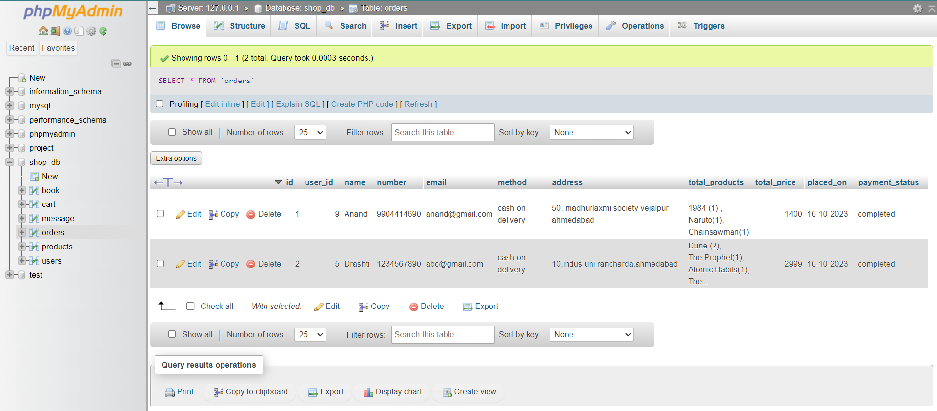

Slide 28
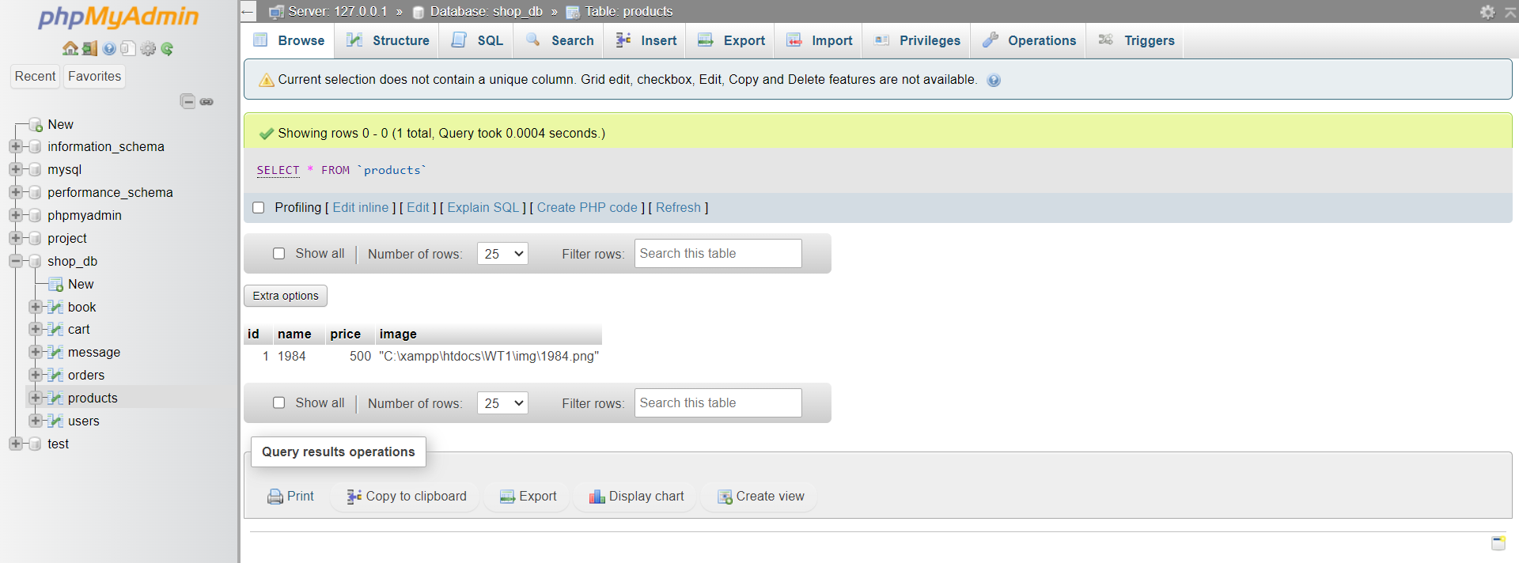

Slide 29
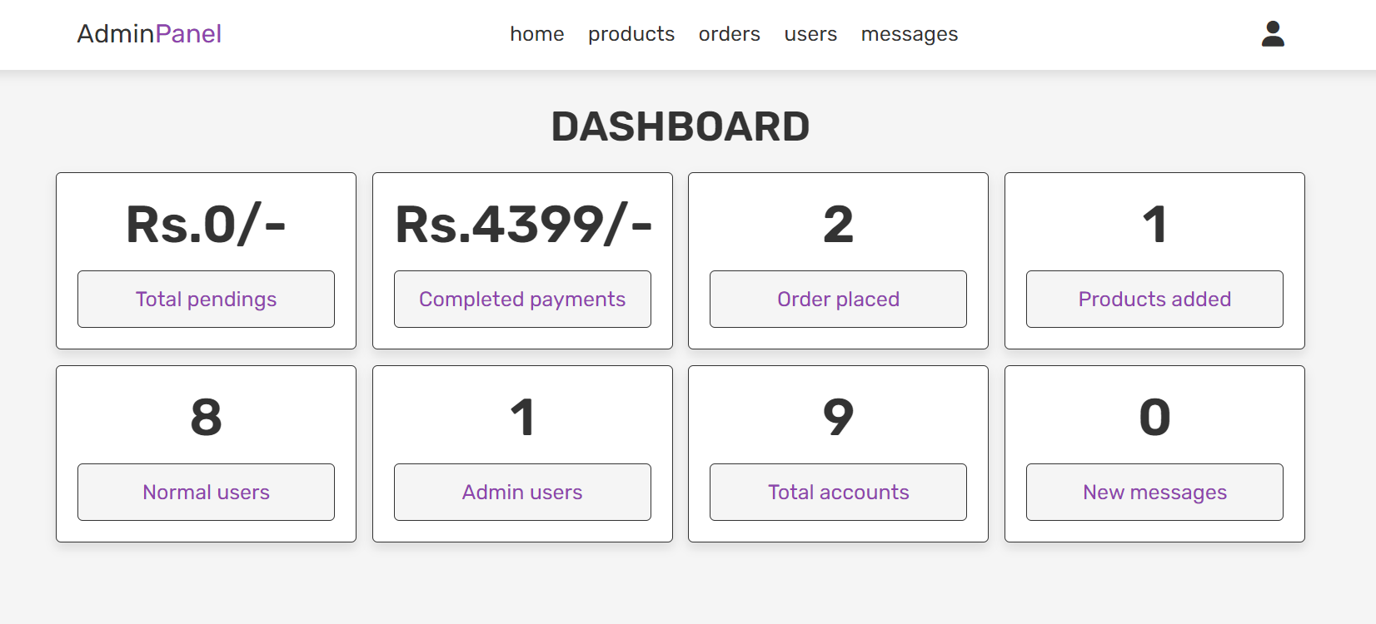
ADMIN PANEL

Slide 30
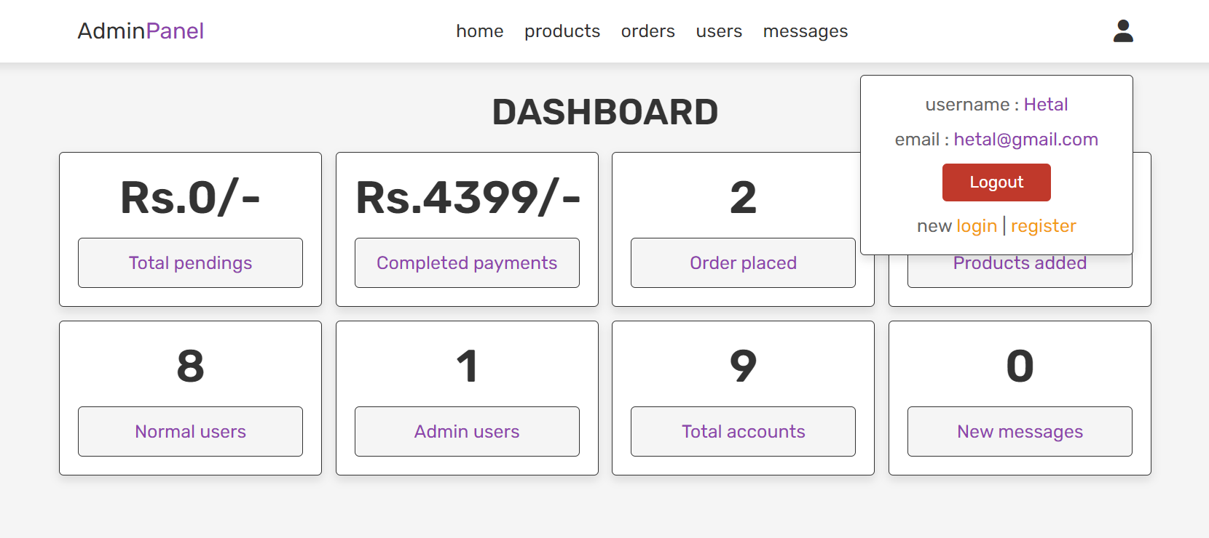
ADMIN LOGOUT

Slide 31
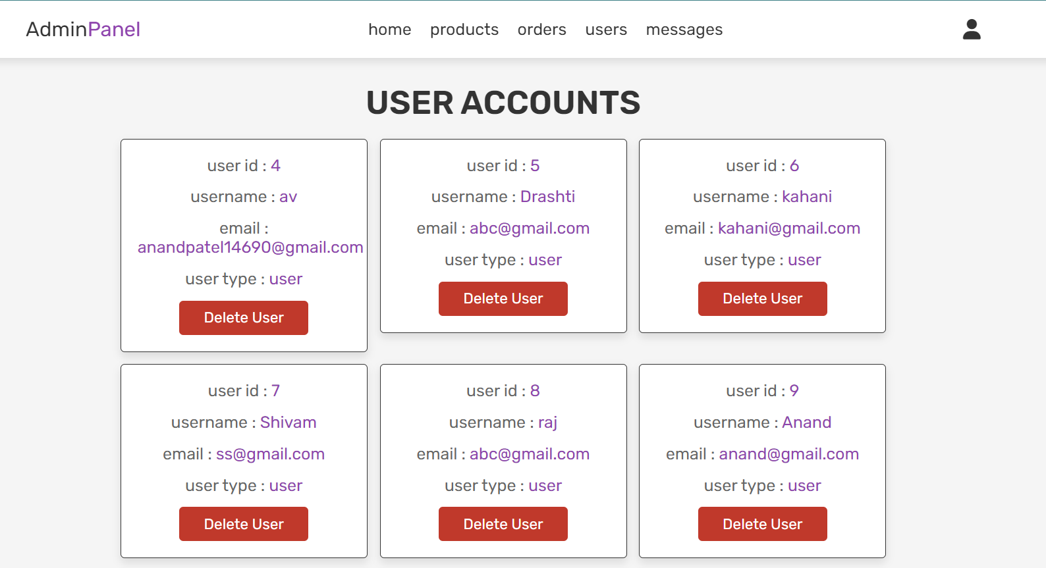
ADMIN PANEL

Slide 32
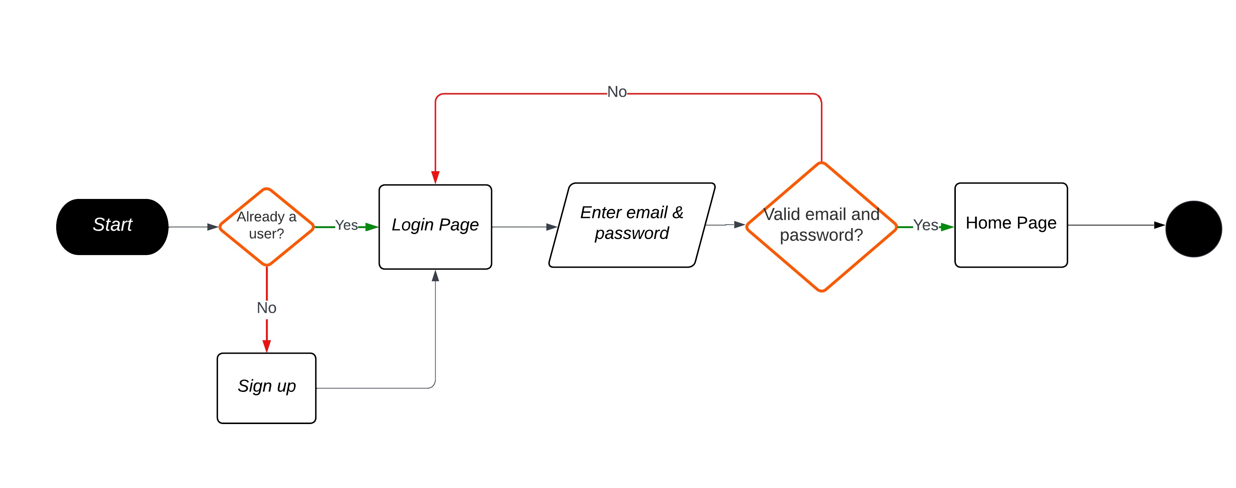
FLOW CHART OF WEBSITE

Slide 33
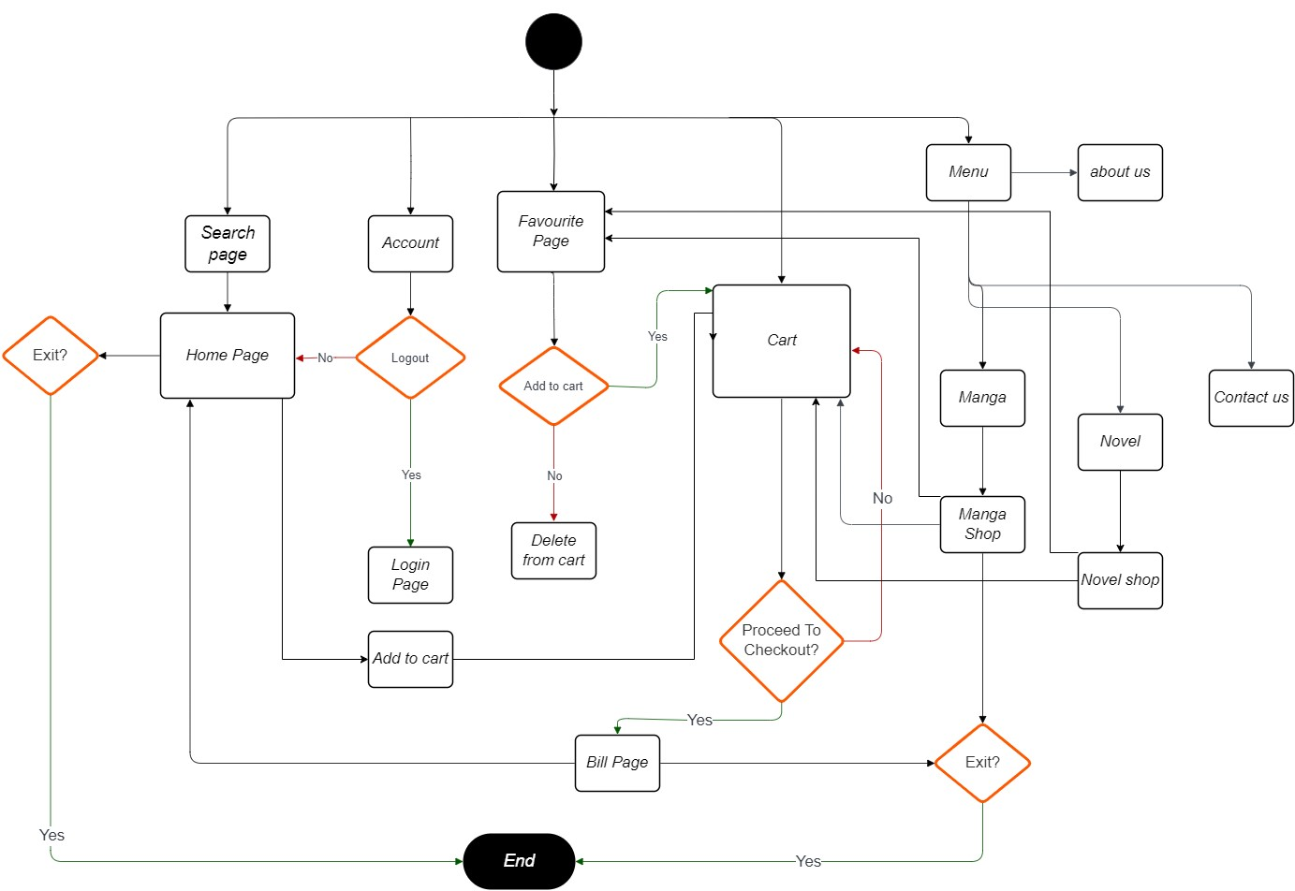

Slide 34
TESTING RESULTS AND PROCEDURES
1) User Registration and Login:
Verify that users can register and login successfully.
Test password recovery/reset functionality.
2) Book Search:
Ensure the search bar returns relevant results.
3) Book Listing and Details:
Confirm that book details (title, author, description) are displayed accurately.
Verify that book covers and other media load properly.
4) Shopping Cart:
Test adding/removing items from the shopping cart.
Confirm the accuracy of the total price calculation.

Slide 35
USABILITY TESTING
Navigation:
Assess the website’s navigation for intuitive menu and page structure.
2) Responsive Design:
Test the website on various device ( desktop , mobile , tablet).
Ensure it adapts well to different screen sizes.
3) Performance:
Evaluate page loading speed to prevent slow or unresponsive pages.

Slide 36
CHALLENGES DURING IMPLEMENTATION
Content Management:
Managing a large volume and variety of book content was challenging.
User Experience (UX):
Designing an intuitive navigation system for users to easily find books.
Ensuring that the website works well across different devices and screen sizes.
Technical Challenges:
Designing database was quite challenging.
Protecting user data and preventing unauthorized access.

Slide 37
SUMMARY OF BOOK WEBSITE
The book website project aimed to establish a robust online platform for readers and literary enthusiasts, with specific goals and objectives in mind.
In conclusion, the book website project successfully achieved its main goals, increasing book sales, author and title online visibility, user engagement. A dedication to long-term success and user pleasure is demonstrated by ongoing efforts to collect and implement user input. With this iterative process, the book website is kept dynamic and ready for long-term expansion in the literary world.

Slide 38
FUTURE WORK & RECOMMENDATIONS
Mobile App Development.
User-Generated Content.
Advanced Search and Filtering.
Data Analytics for Decision Making.
Accessibility Improvements.
Partnerships and Collaborations.

Slide 39
THANK YOU

